Slide 1

Project # 4 Data Model Implementation
Walmart Sales Predictions
Ana Brissa Miranda
Santiago Ayala
Ana Sofia Garrido

Slide 2

Overview:
Walmart Sales
Data obtained from
https://www.kaggle.com/code/aslanahmedov/walmart-sales-forecasting/input
Data contains sales from 2010 to 2012
The project aims to predict sales using Lineal Regression and Random Regression models.
We used 4 data sets and merged them:
Features
Test
Stores
Train

Slide 3
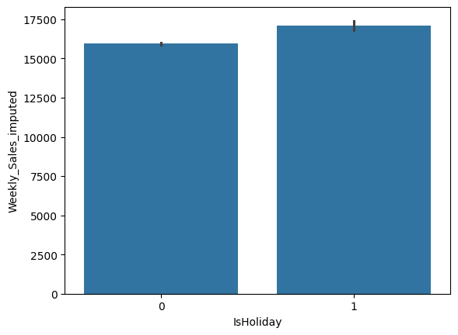
Data Clean up:
Spark Session was used due to the big data.
Using code and seaborn lineal plot heatmap, determine the relation and correlation between the variables.

Slide 4
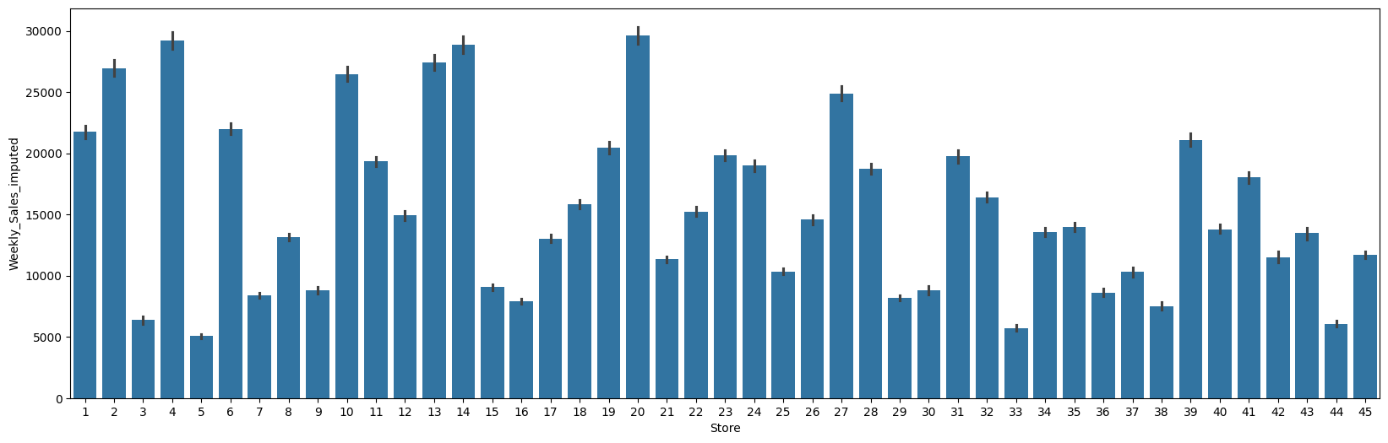
Data Clean up:
Relation of Stores vs Weekly Sales

Slide 5
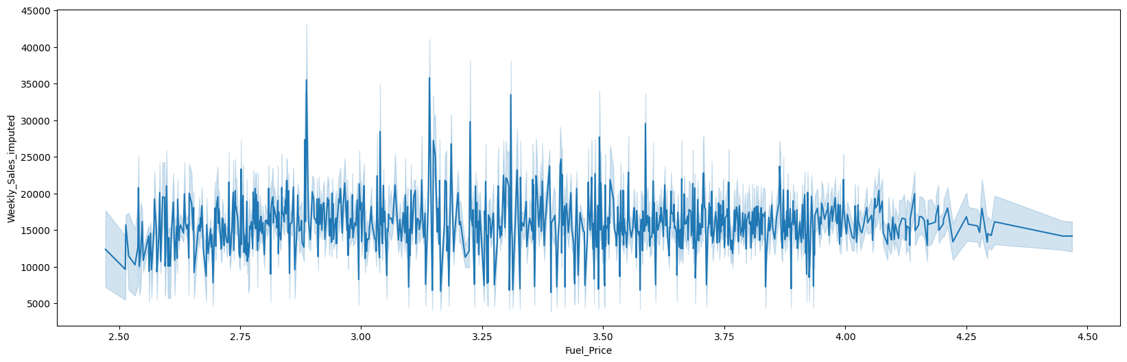
Data clean up:
Relation between WK Sales and Fuel Price
We noticed that Fuel Price and WK Sales doen’t have any correlation

Slide 6
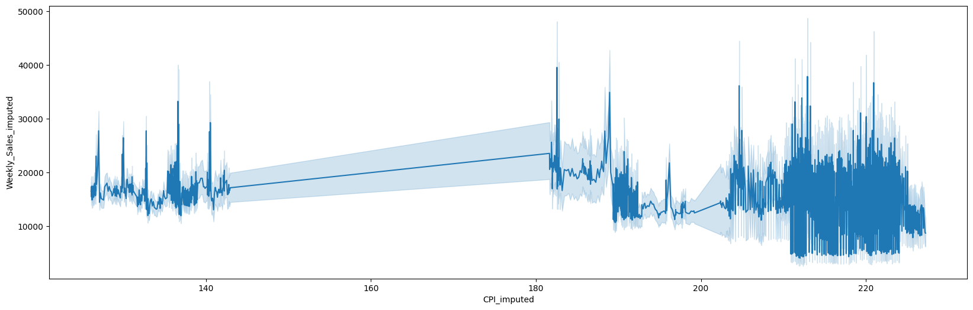
Data Clean up:
WK Sales vs CPI (Consumer Price Index)
There isn’t any relation between them.

Slide 7
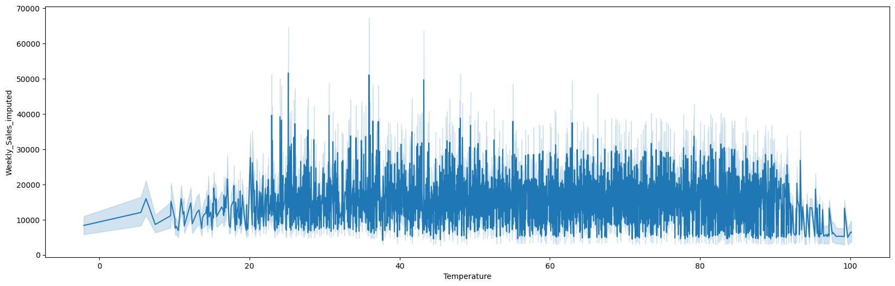
Data Clean up:
WK Sales vs Temperature
There isn’t any relation between them

Slide 8
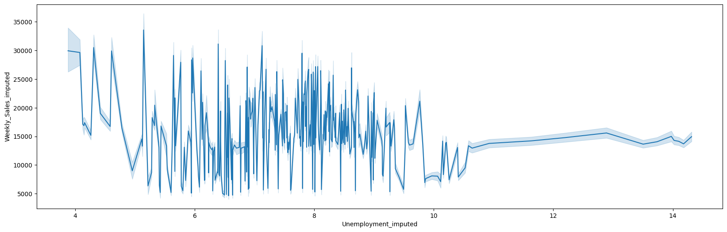
Data clean up:
WK Sales vs Unemployment
There isn’t relation between them

Slide 9
Tableau Results
https://public.tableau.com/app/profile/santiago.ayala.lomelin/viz/WalmartProyecto4/Dashboard1?publish=yes

